Slide 1
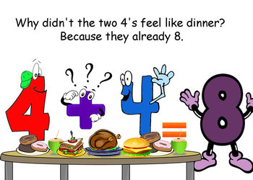
Number
Term 1
Semester 1
Teacher:
Class:

Slide 2
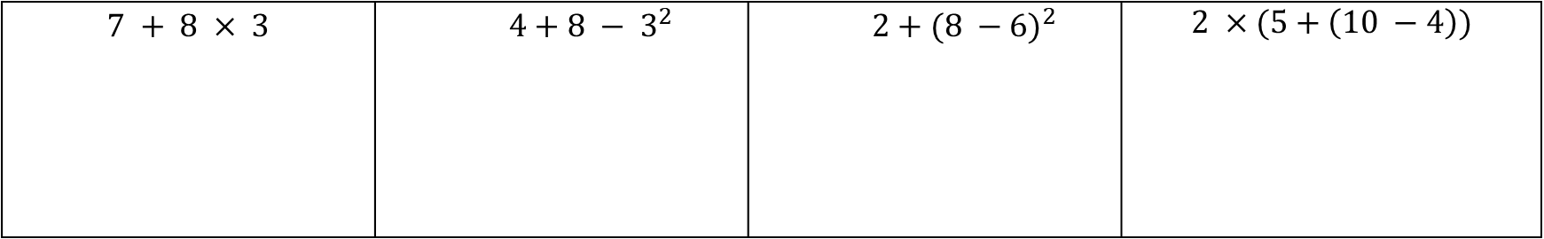
24
7
30
Topic: ESTIMATING & ROUNDING
Date
Essential Question:
How do we estimate and round whole numbers and decimals?
Questions
Notes:
Example :
REVISION QUESTIONS
$$7 + 8 × 3$$ | $$4+8 − 3^{2}$$ | $$2+{(8 −6)}^{2}$$ | $$2 ×(5+\left(10 −4\right))$$
5

Slide 3
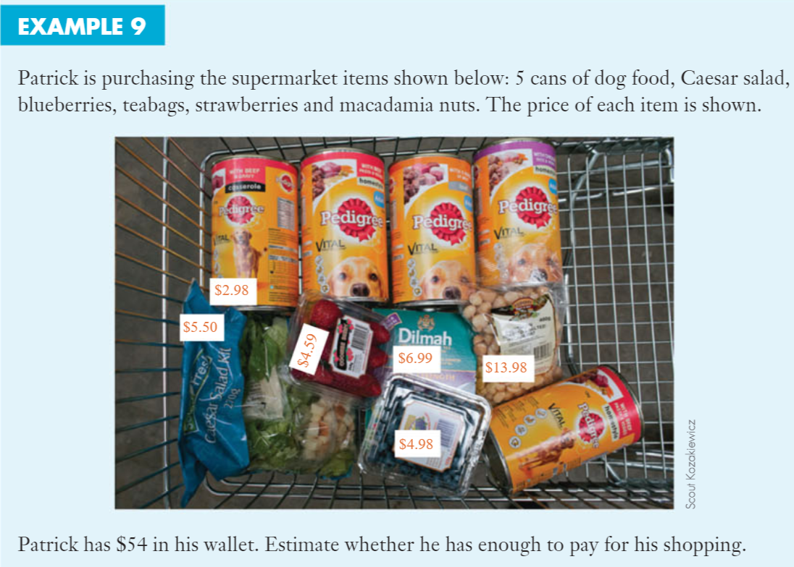
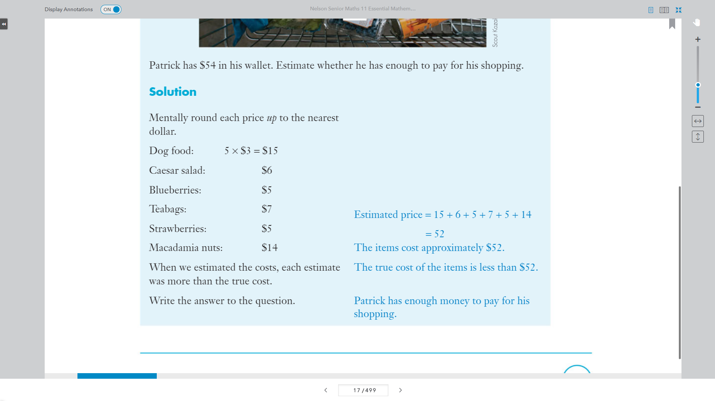

Slide 4
24
7
30
Topic: ESTIMATING & ROUNDING
Date
Essential Question:
How do we estimate and round whole numbers and decimals?
Questions
Notes:
What is estimation?
To find a value that is close enough to the right answer.
What is leading digit estimation?
Look at the first or ‘leading’ digit and add zeros.
5

Slide 5
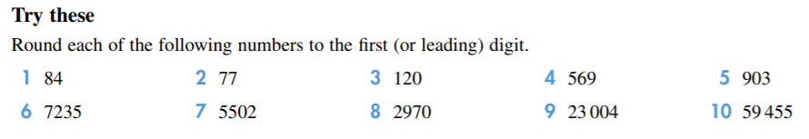

Slide 6
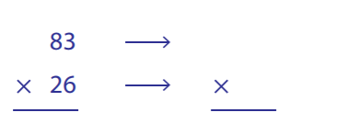
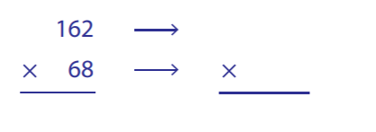
46 + 153 + 71 =
837 -244 =

Slide 7
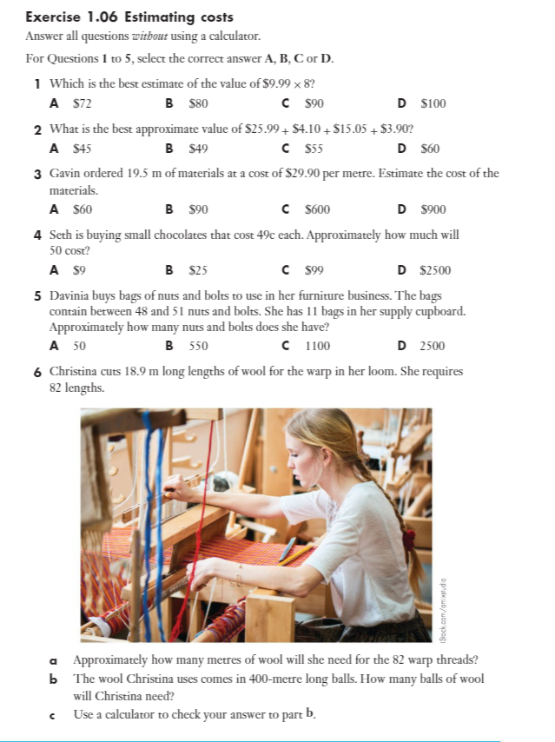
Page 18 & 19
Exercise 1.06

Slide 8
